Slide 1
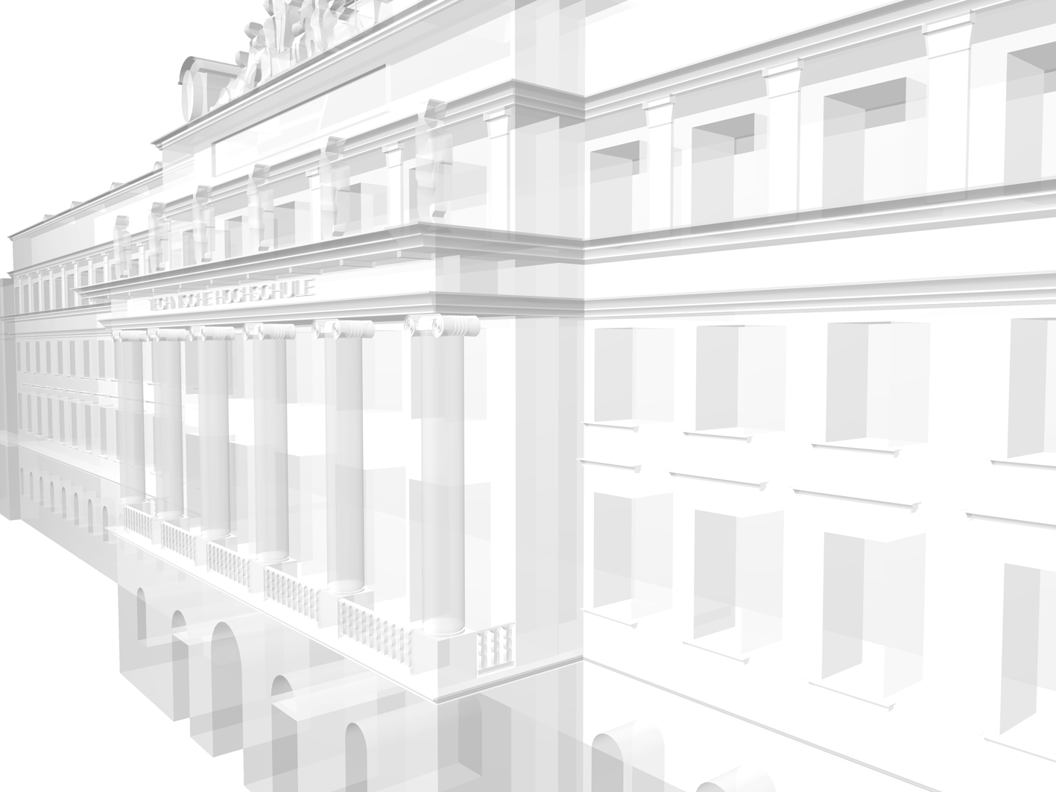
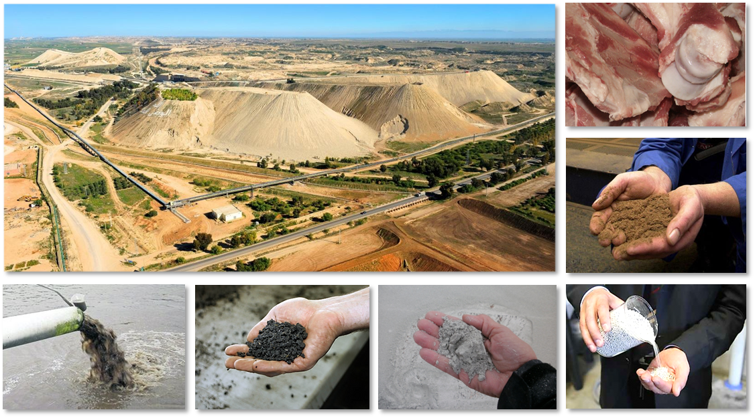
VIENNA UNIVERSITY OF TECHNOLOGY Technische Universität Wien
Institute for Water Quality Resource and Waste Management
Phosphorus recovery from wastewater:
Comparative assessment of P recovery potential, removal of pollutants and costs
SPS 2014 Montpellier 1.-3.09.14
Lukas Egle*
Helmut Rechberger
Matthias Zessner

Slide 2
Introduction
National P budgets exhibit great P potential in wastewater and meat and bone meal
Great progress in the recovery of wastewater P
Manifold technological approaches are available
Unfortunately, comparability is often not given (Decision makers, politics)
Study „P-Recycling from Waste Water“ at the Vienna Technical University
Integrated comparative technological, environmental and economic assessment
Todays focus: ① P recovery potential ② heavy metal depollution and ③ costs

Slide 3
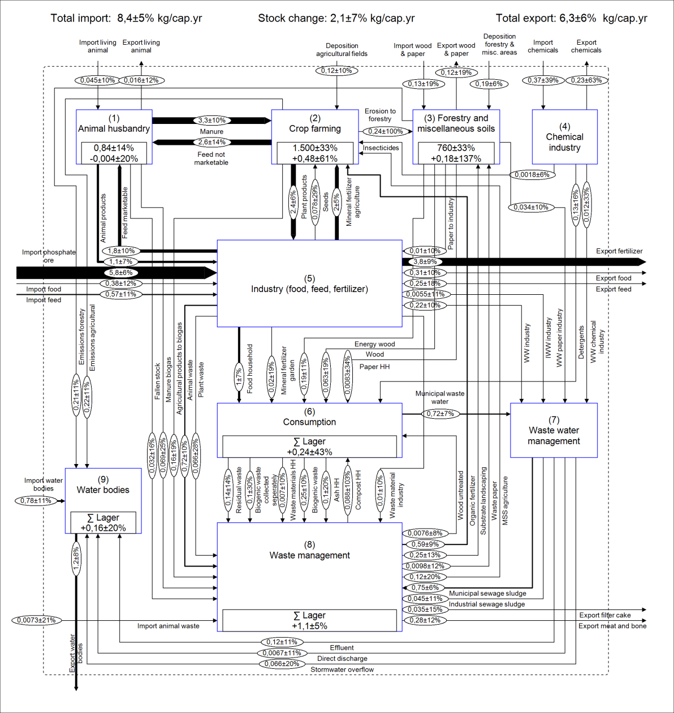
Exkurs: Urban P potential
Latest data Austria
Mineral fertilizer application
11.400 t P/a or 1,4 kg P/inh.*a
Sewage Sludge
6.600 t P/a or 0,80 kg P/inh.*a
Meat and Bone Meal
~4.000 t P/a or ~0,50 kg P/inh.*a

Slide 4
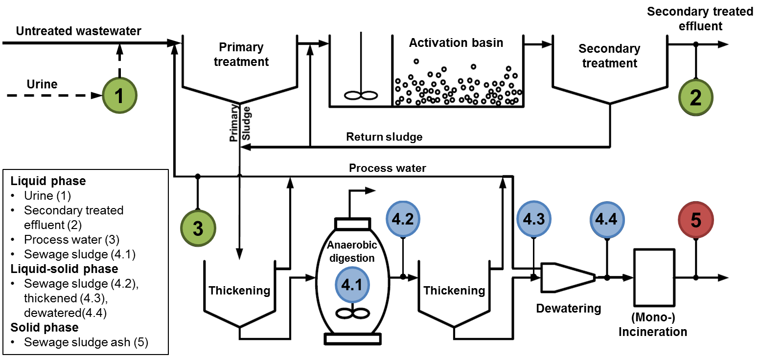
Overview: P recovery technologies

Slide 5
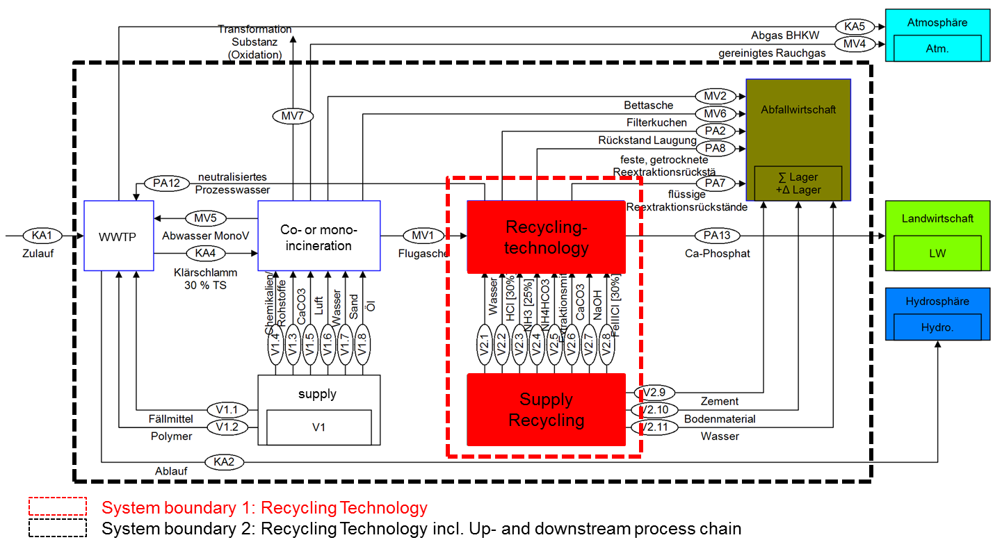
Methodology: Material Flow Analysis (MFA)
Reference processes und reference system (100.000 PE)
Modular system

Slide 6
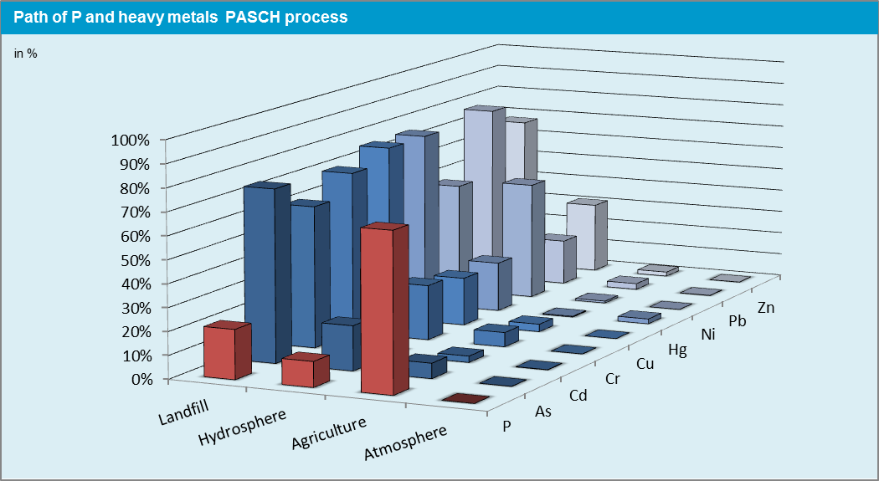
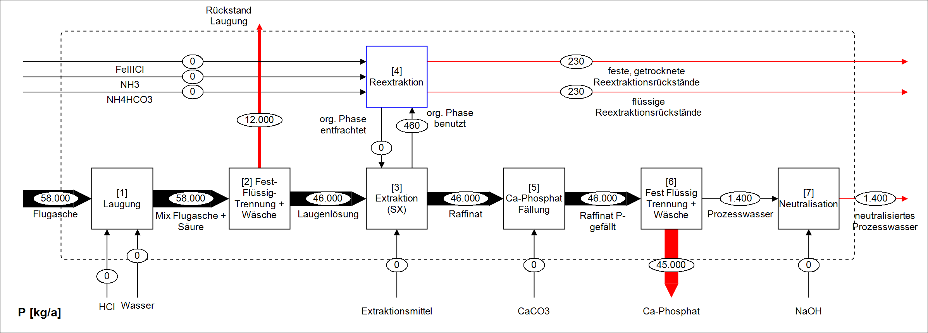
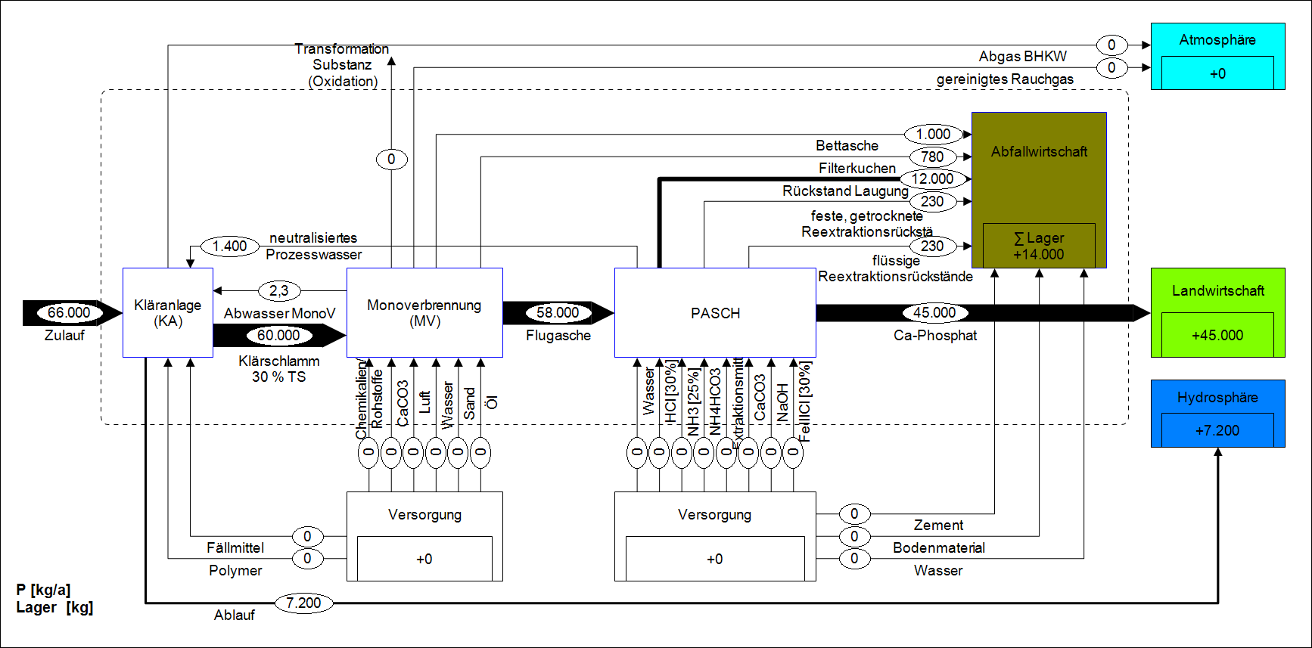
Example: Path of P and heavy metals

Slide 7
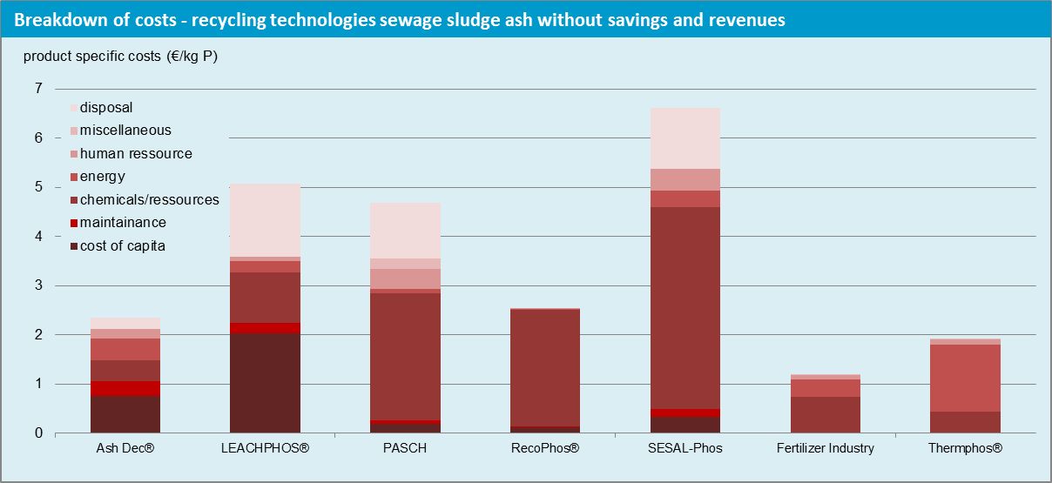
Methodology: Costs
MFA is the basis for resource- and energy demand, occurring products and wastes (life-cycle-inventory)
Investment costs from feasibility studies and other calculations (high uncertainty)
Revenue for the product was calculated for the contained nutrients (no market so far → high uncertainty)
Breakdown of costs
Running costs
Annual costs
Take into account the whole system

Slide 8
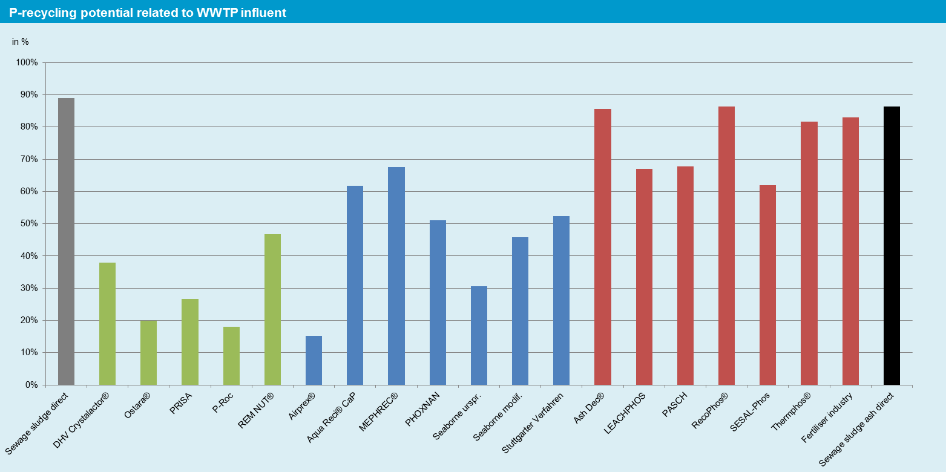
Result: P recovery potential
Sludge Water: 20–30 % with respect to WWTP influent → National: ~16 %
Sewage sludge: 40–70 % with respect to WWTP influent → National: 30–36 %
Sewage sludge ash: 65–85% with respect to WWTP influent → National: 62–81 %
7

Slide 9
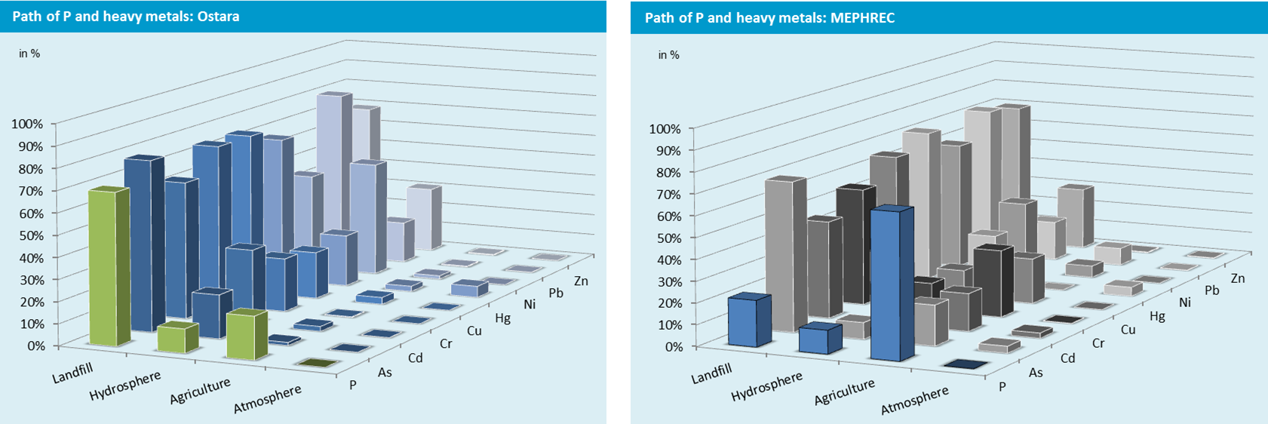
Removal of heavy metals (I)
No heavy metal removal necessary in sludge water
Very good heavy metal removal with almost all recycling technologies from sewage sludge (except MEPHREC®*)
Strongly differing results for technologies to recycling P from sewage sludge ash

Slide 10
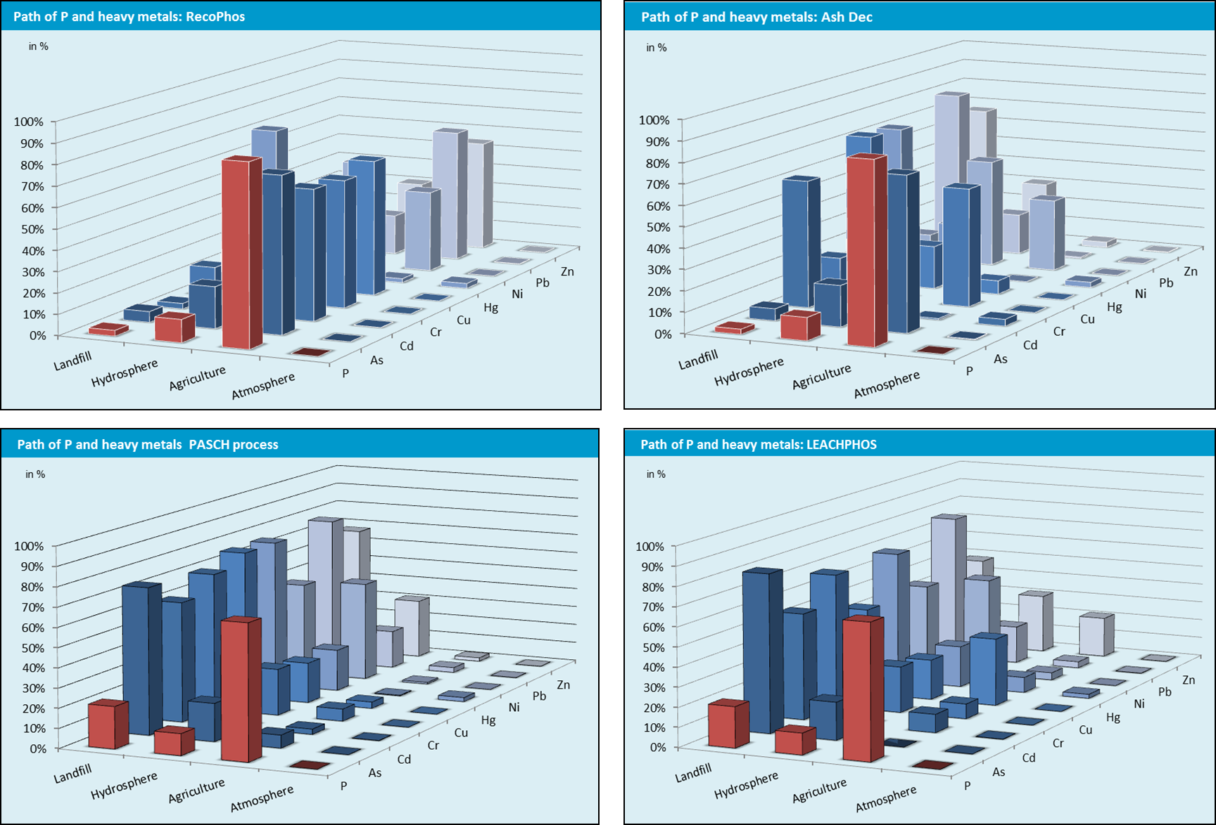
Removal of heavy metals (II)

Slide 11
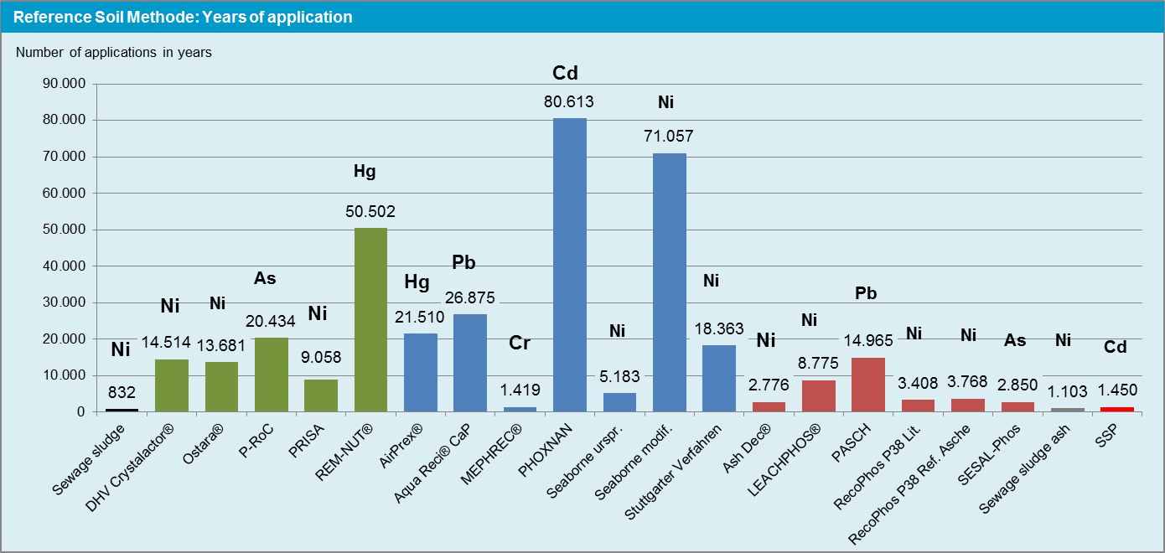
Reference Soil Method
Number of applications of a recycling fertilizer until a tolerable heavy metal concentration will exceed in a defined reference soil

Slide 12
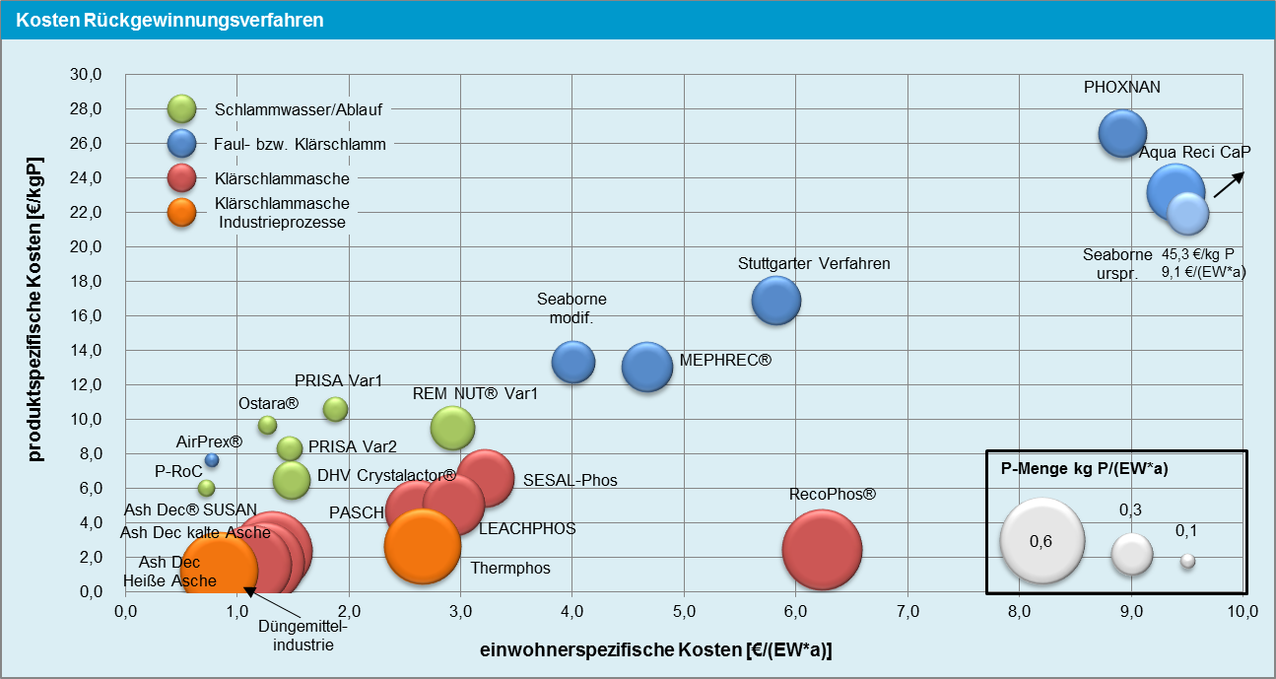
Costs (I)
Basis of calculation: Annual costs without savings and revenues
Sludge Water/Effluent and Sewage sludge: 100.000 PE
Sewage sludge ash/industrial processes: 30.000 t ash
11
11

Slide 13
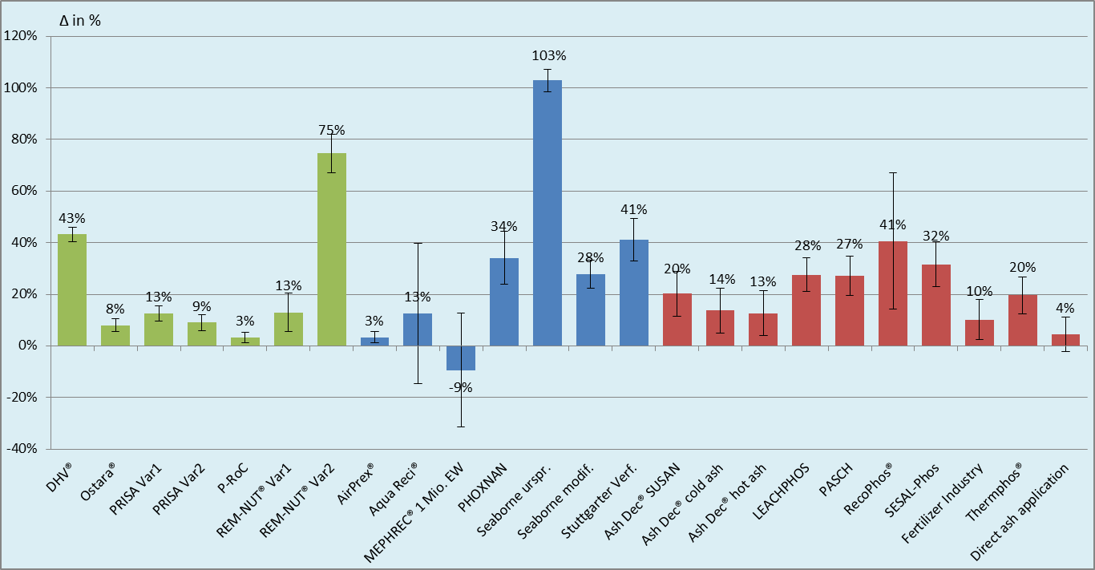
Costs (II)
Basis of calculation: Costs for recycling technologies regarding the whole process chain with possible savings and revenues. Result: Additional costs for sanitary environmental engineering (reference costs without P-Recycling: 11,1 €/PE*yr)
monoincineration

Slide 14
Take Home Messages (I)
Remarkable but often unexploited P potential
Comprehensive assessment of a technology in context with preconditions in sanitary environmental engineering
Basis for optimized P-management has been created
Sludge water: simple technologies, economic operation is possible, advantages for WWTPs, very good final products → but low recycling potential (20–30%) related to WWTP influent
Sewage Sludge: Manifold different approaches with varying results, often limited recycling potential (50–70%) related to WWTP influent, possible waste by-products (further treatment), complex approaches, resource intensive and expensive (> 10 €/kg P)

Slide 15
Take Home Messages (II)
Sewage sludge ash: Fundamental decision:
Maximum of heavy metal removal – lower P recycling
Maximum of P recycling – no or incomplete HM-removal
Avoiding incineration with wastes poor in P but “dope” the ash with additional P-rich wastes e.g., meat and bone meal
High recycling potential: 70–85 % related to WWTP influent
Additional costs:
With heavy HM removal: +30 % for 60 % of wastewater P
Without or partially HM removal: + 10 % to recover 80 % of wastewater P
Big advantage for ash: temporary storage and direct use in already existing industries (e.g. fertilizer industry)

Slide 16
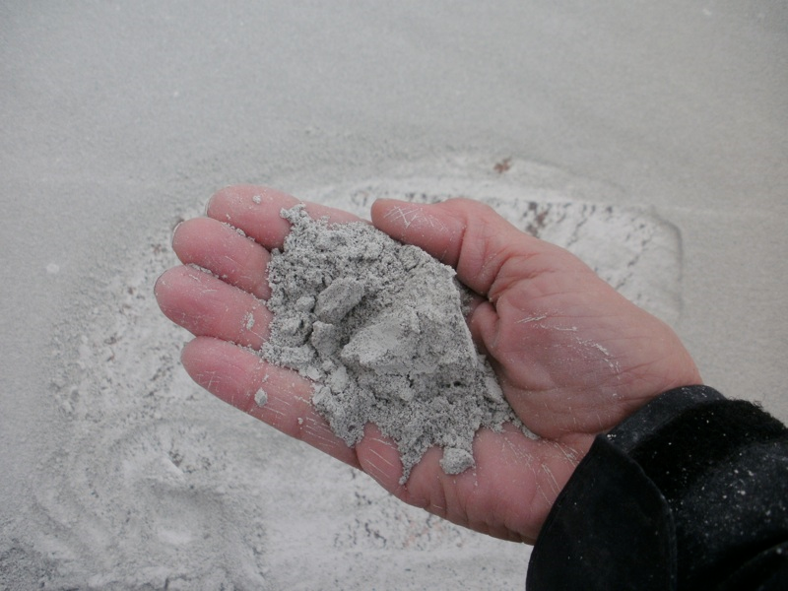
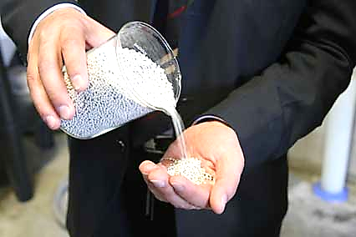
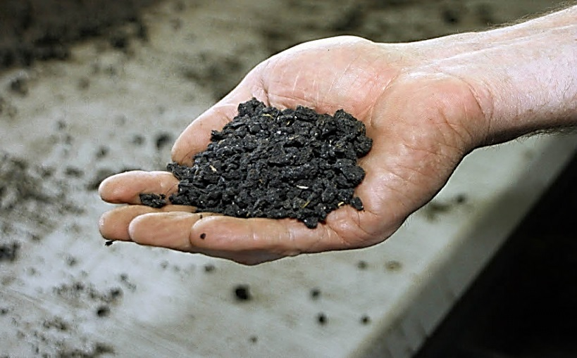
Thank you for your Attention!
Study „P-Recycling from Waste Water“
Vienna University of Technology
Institute for Water Quality, Resource and Waste Management
E-Mail: l.egle@iwag.tuwien.ac.at
http://iwr.tuwien.ac.at/wasser
15

