Slide 1
Opportunities with phosphorus and threats with cadmium in fertilizers
Mike McLaughlin
The University of Adelaide Fertiliser Technology Research Centre
Agriculture Flagship

Slide 2
Overview
Reactions of added fertilizer P in soils
The (partial) myth of P fixation
Opportunities for P efficiency gains
The need for science to develop/validate new P efficiency technologies in agriculture
Reactions of added fertilizer Cd in soils
Management of fertilizer Cd in agroecosystems
Are risks due to fertilizer Cd receding?
Summary

Slide 3
Reactions of added fertilizer P in soils

Slide 4
The fate of added fertilizer P in soil
Fertilizer P
Plant
P
Microbial
P
Soil
soln
Inorganic
P
Organic
P

Slide 5
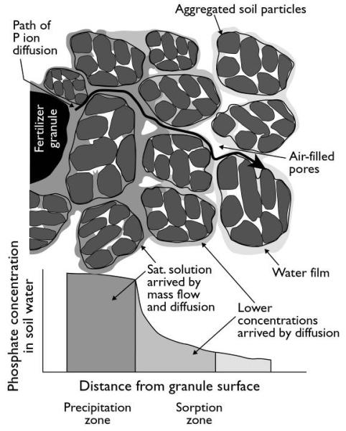
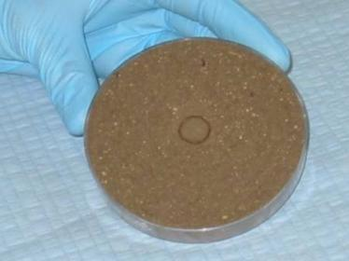
Reactions of added fertilizer P
Hedley and McLaughlin (1992)

Slide 6
The (partial) myth of P fixation

Slide 7
Crop P responses to P over time
Inorganic P
Soil
soln
Organic P
Crop Yield (t/ha)
P applied (kg/ha)

Slide 8
Fertilizer P requirements over time
P applied (kg/ha)
Maintenance
Time

Slide 9
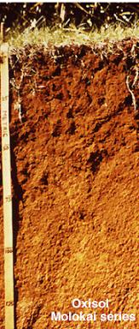
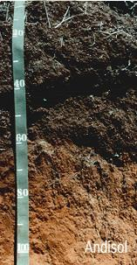
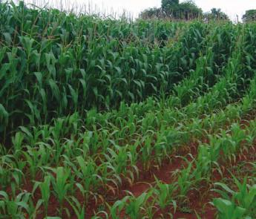
Soils with strong P adsorption
Al/Fe oxides
Allophane
Source: De Sousa, 2011

Slide 10
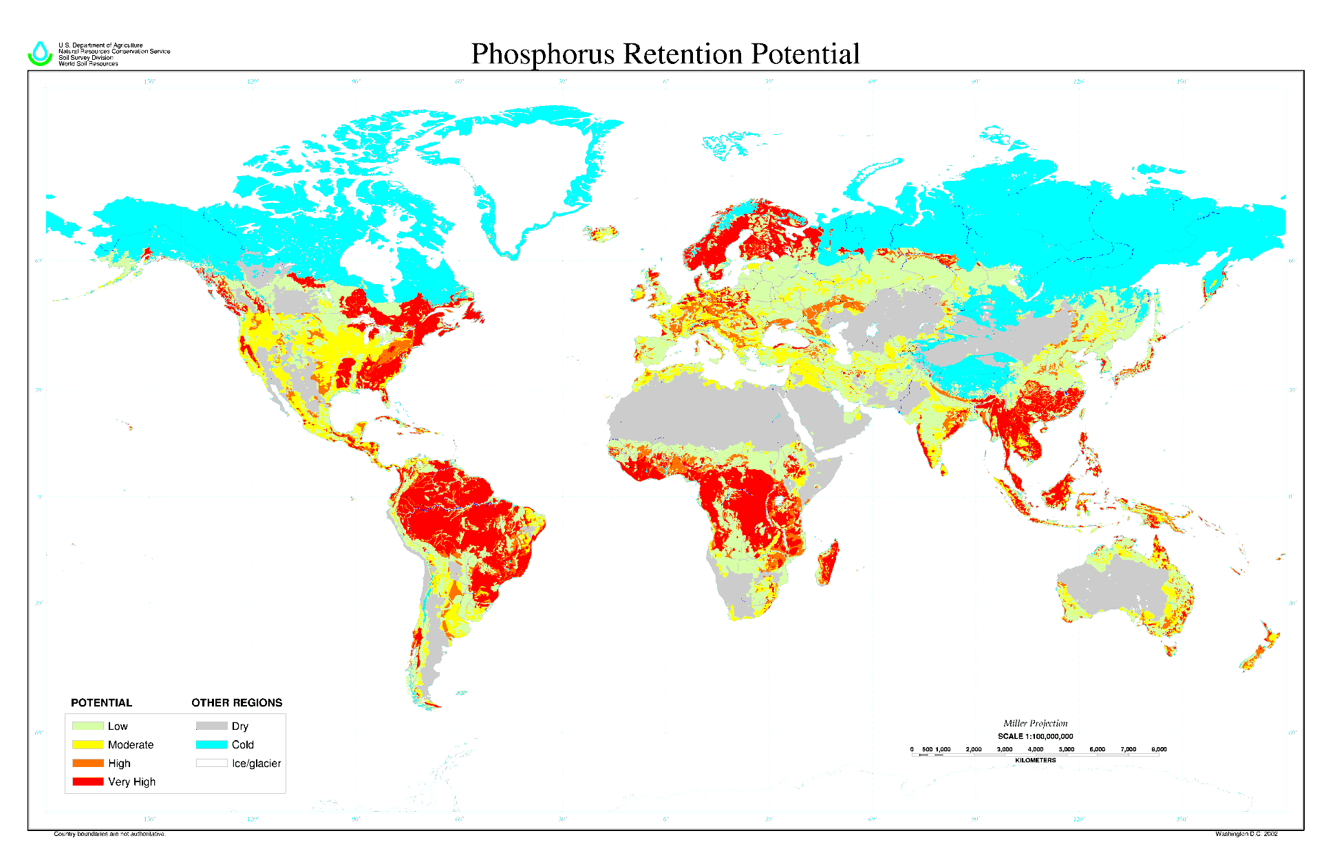
Global coverage of highly sorbing soils
www.nrcs.usda.gov

Slide 11
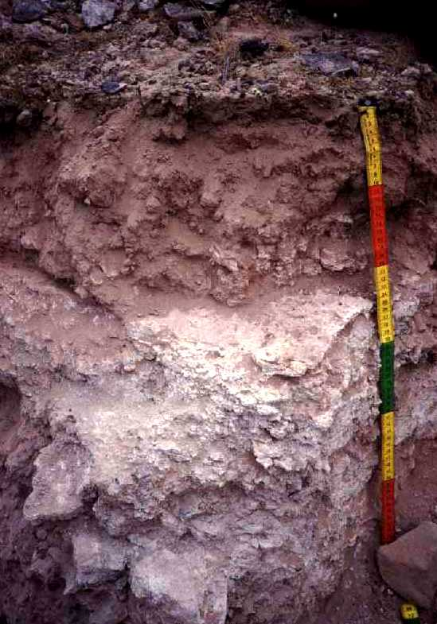
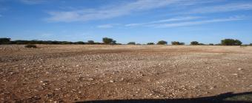
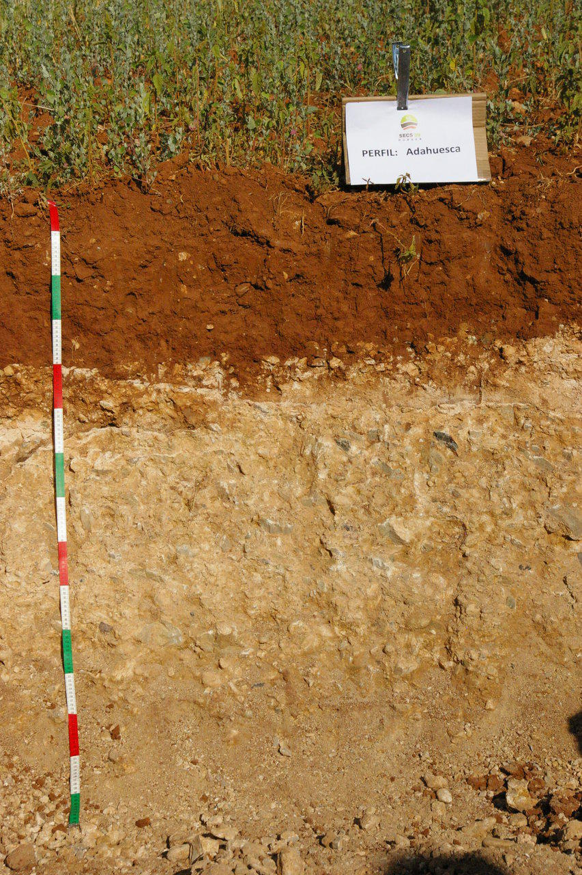
Soils with strong P precipitation
Calcisols
Calcarosols
Source: ISRIC
CaCO₃
MgCO₃
Source: Jorge.Mataix

Slide 12
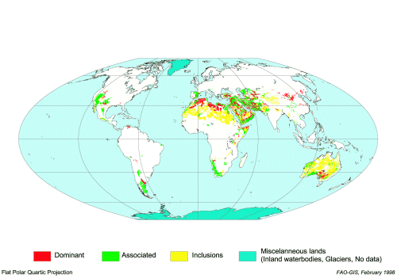
Global coverage of calcareous soils
Source: FAO

Slide 13
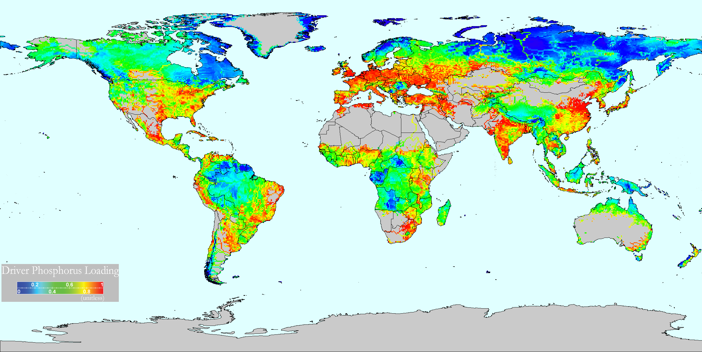
Where is P “fixation” a real problem?
√
X
X
X
√
√
√
√
√
Source: Vorosmarty CJ, McIntyre PB, et al. (2010) Nature 467(7315), 555-561.

Slide 14
Opportunities to improve efficiency

Slide 15
Opportunities to improve P efficiency
The largest and biggest gains in P efficiency in agriculture are achieved by modifying the application rate
If the crop/animal system does not need P to attain the desired production, add less (or no) P (until economic responses to P are predicted)

Slide 16
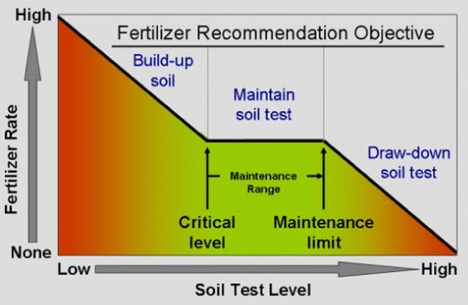
Fertilizer P recommendations
Source: http://msue.anr.msu.edu

Slide 17
The fate of added fertilizer P in soil
?
Inefficiency terms
Fertilizer P
(if required)
Erosion
Leaching/runoff
Strong sorption or ppt
Occlusion in OM
Plant
P
Microbial
P
◆
Soil
soln
❖
Inorganic
P
Organic
P
❖
⬥


Slide 18
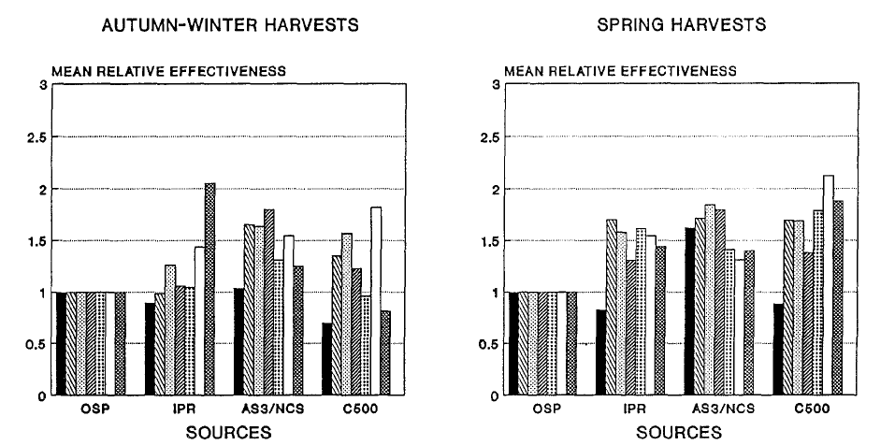
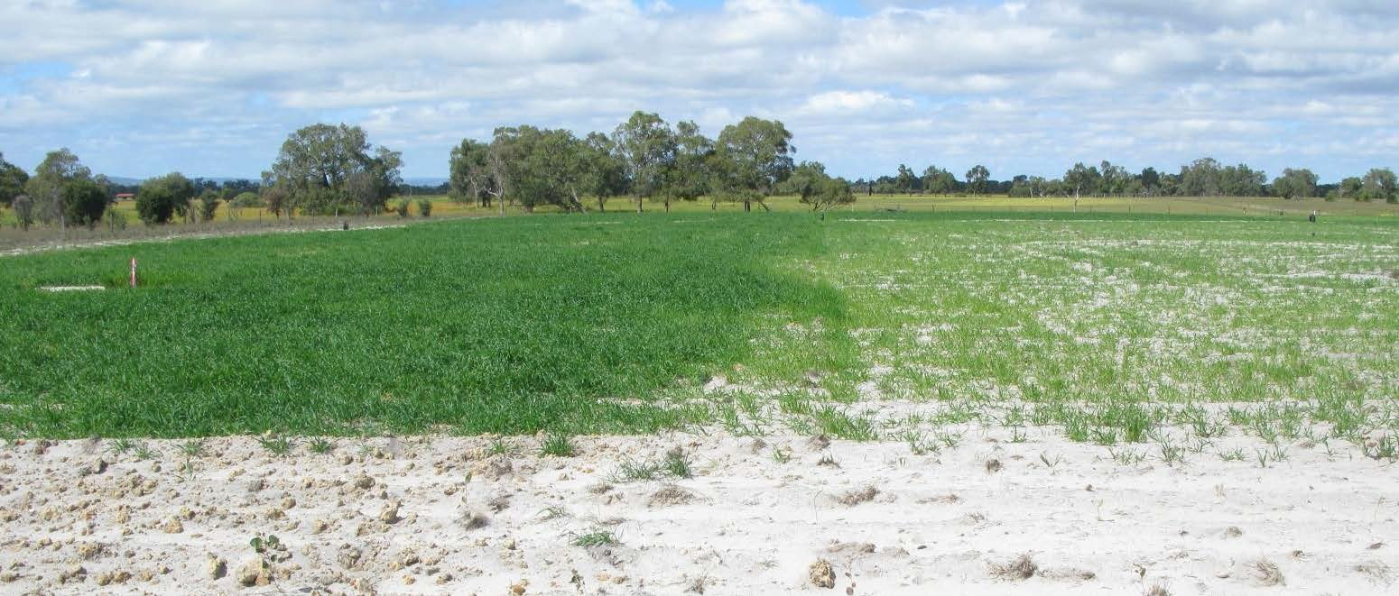
Field evidence of efficiency of slow release P
Slow release P
Soluble P
Source: Water Corporation of Western Australia
Yeates JS, Clarke MF (1993) Fertilizer Research 36(2), 141-150.

Slide 19
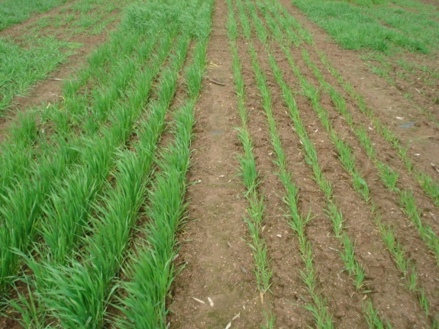
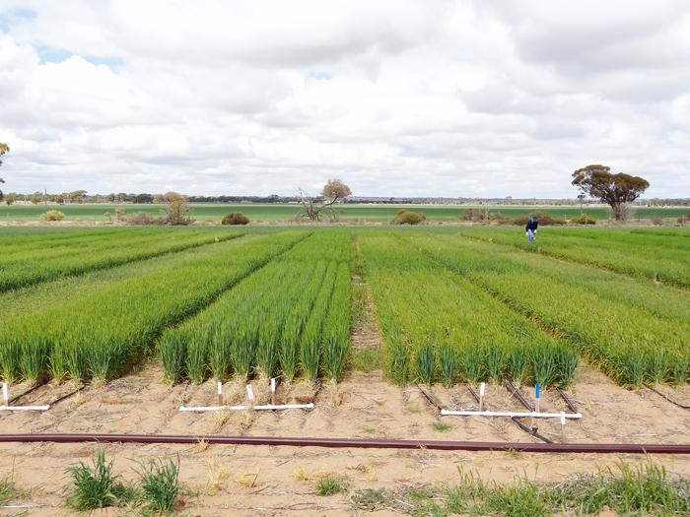
Field evidence of cultivar P efficiency
Source: Glenn Macdonald and GRDC

Slide 20
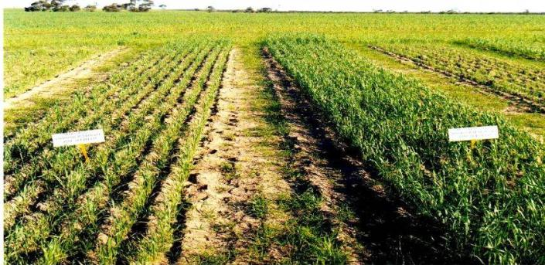
Field evidence of efficiency of formulations
Granular MAP
Fluid MAP
Source : Bob Holloway
Holloway et al. 2001 Plant and Soil 236, 209-219.

Slide 21
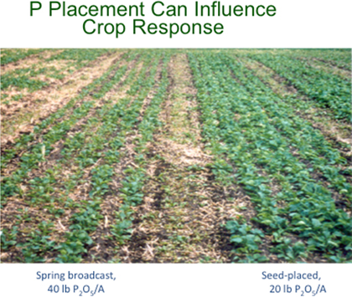
Field evidence of placement effects
Source: bioag.novozymes.com

Slide 22
Improving P efficiency by releasing
“fixed” P/reducing sorption
The scorecard
√
Placement of P e.g. banding
Cultivation to mineralise organic P
Changing fertilizer formulation - fluids
Changing fertilizer formulation – slow release (for leaching)
New fertilizer formulations - chelates, slow release (to reduce sorption)
Inoculants/biostimulants to release “fixed” P
Inoculants/biostimulants to release stable organic P
√
√
√
?
?
?

Slide 23
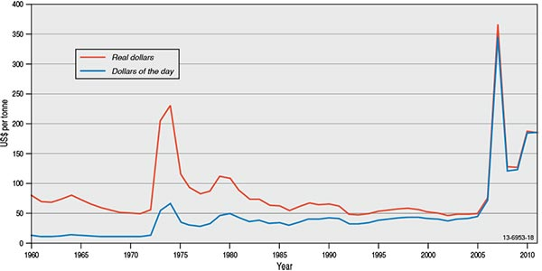
The need for science to validate new P efficiency technologies
Peak “technology” release times
Source: GSA

Slide 24

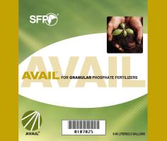


New P efficiency technologies

Slide 25
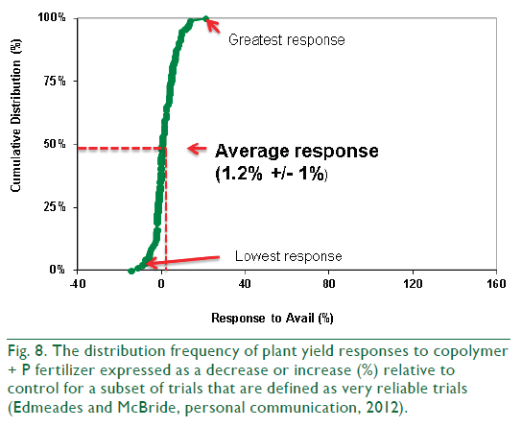
Data compilation of response to the polymer in trials
Chien SH, et al. (2014). Agronomy Journal 106(2), 423-430.

Slide 26
Reactions of added fertilizer Cd in soils

Slide 27
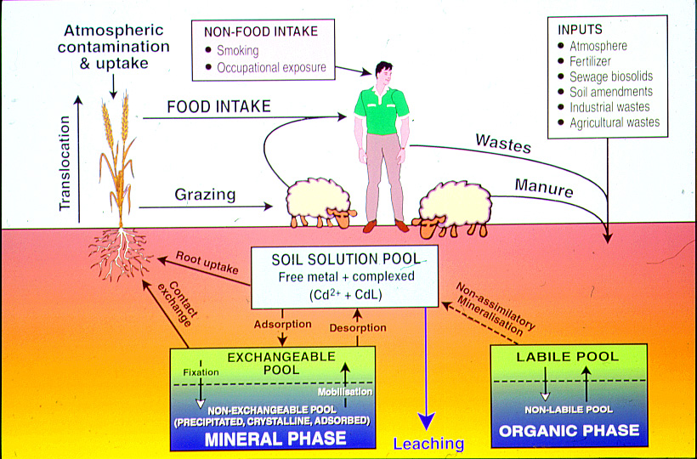
The fate of added Cd in soil

Slide 28
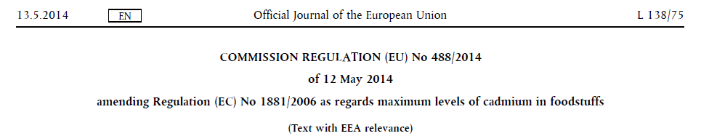
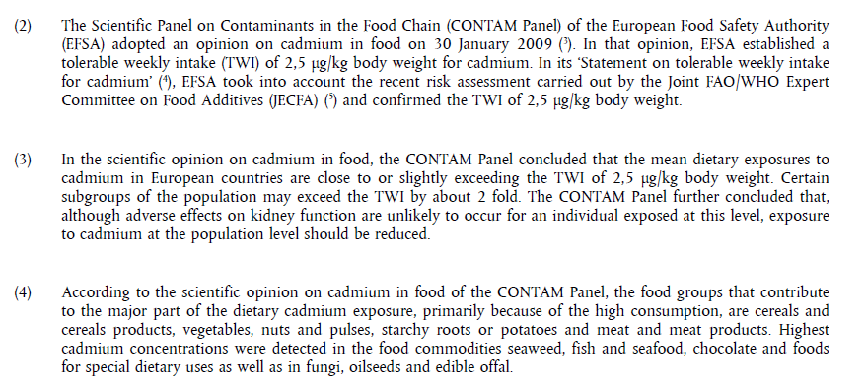
Food regulations drive Cd management

Slide 29
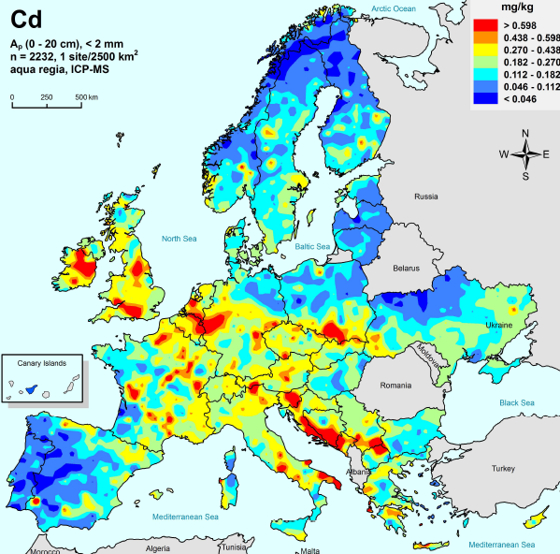
Soil Cd in Europe

Slide 30
Management of fertilizer Cd in soils

Slide 31


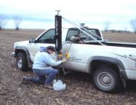
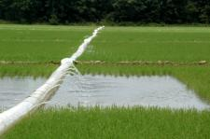



Factors affecting Cd concentration of crops
weather
Crop Genetics
Soil characteristics
Soil Cd concentration
Tillage and agronomic management
Irrigation and water management
Crop Rotation
Fertilizer management

Slide 32
Are fertilizer Cd risks receding?

Slide 33
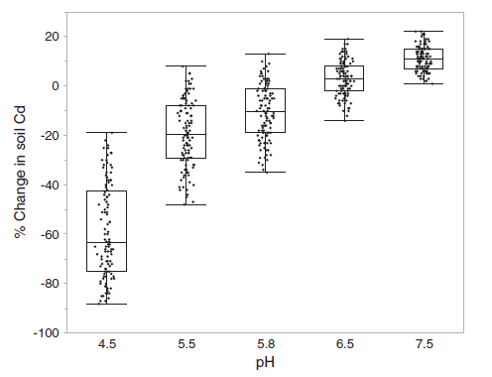
Predicted change in soil Cd over 100 years in 540 potential European scenarios: soil pH is the main driver
Average scenario: 15% depletion
Reduced atmospheric deposition of Cd
Large reductions in use of P fertilizers in EU
Six L, Smolders E (2014) Future trends in soil cadmium concentration under current cadmium fluxes to European agricultural soils. Science of the Total Environment 485, 319-328.

Slide 34
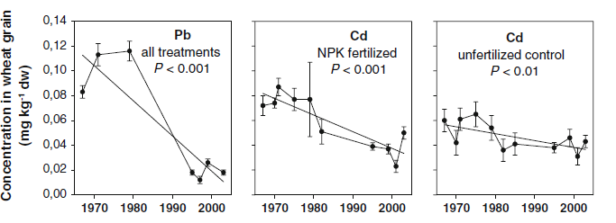
Cadmium in European crops now declining
Kirchmann H, Mattsson L, Eriksson J (2009) Trace element concentration in wheat grain: results from the Swedish long-term soil fertility experiments and national monitoring program. Environmental Geochemistry and Health 31(5), 561-571.

Slide 35
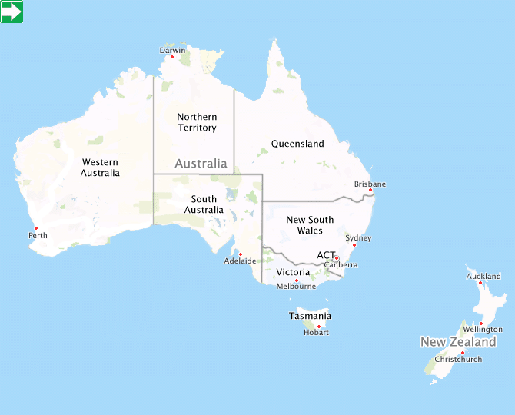
Cadmium in Australian agroecosystems
Low geogenic soil Cd
Minimal atmospheric Cd deposition
History of low P additions in fertilizer from island rocks having higher Cd
Generally sandy soils, low organic matter, high salinity

Slide 36
Soil Cd closely linked to fertilizer addition
EDTA-extractable Cd (mg/kg)
H₂SO₄-extractable P (mg/kg)
Merry, R. H., (1992) CSIRO Report to MRC/FIFA, Australia.

Slide 37
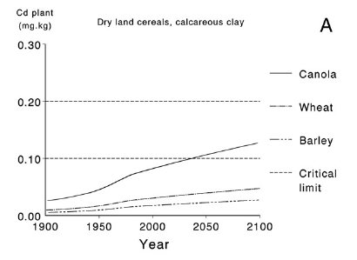
Predicting crop Cd concentrations over time
EU limit for canola
FSANZ limits for cereals
Vries W de, McLaughlin MJ (2013). Sci. Tot. Environ. 461-462, 240-257.

Slide 38
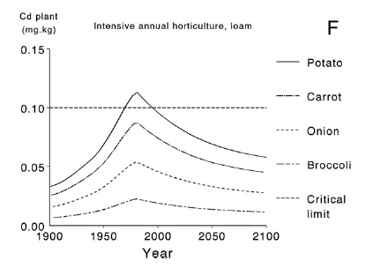
Predicting crop Cd concentrations over time
Reduced input of fertilizer Cd (lower Cd ferts)
Reduced inputs of P
FSANZ limit
Vries W de, McLaughlin MJ (2013). Sci. Tot. Environ. 461-462, 240-257.

Slide 39
“Critical” Cd concentrations in fertilizers
Current average fertilizer quality used in Australia = ~60 mg Cd/kg P
Vries W de, McLaughlin MJ (2013). Sci. Tot. Environ. 461-462, 240-257.

Slide 40
Summary
Efficiency of P fertilizer use may not be as low as you think – over-application is often the key cause
Some soils do not need novel P “enhancers”
Work on improving P efficiency is most critical for developing countries with high-sorption soils having had poor P fertilizer inputs
A combination of plant, fertilizer formulation/ management and soil factors can be used to improve P efficiency
New “P efficiency” technologies need proper mechanistic and field evaluation

Slide 41
Summary
Cadmium is of concern in fertilizers, but is not as big as hazard for P use as previously thought
Cadmium build-up in soils is much lower than previously predicted due to
In the short term, agronomic management can effectively control food chain Cd contamination
More data and modelling needed for developing countries
Lower atmospheric Cd inputs (in Europe)
Lower fertilizer P (Cd) inputs (as soils become “P fertile”)
Greater control of Cd quality of other soil amendments

Slide 42

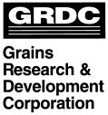








Acknowledgements

Slide 43
Thank you
The University of Adelaide Fertiliser Technology Research Centre
Agriculture Flagship

