Slide 1
Environmental Considerations of Phosphorus Use
Rich. McDowell

Slide 2
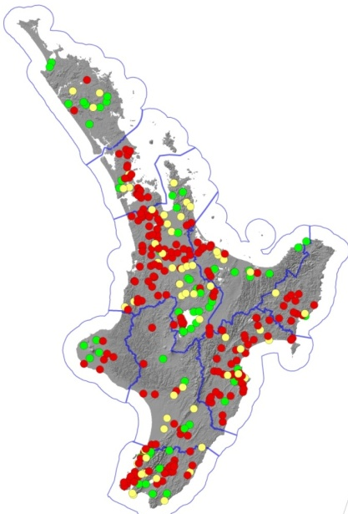
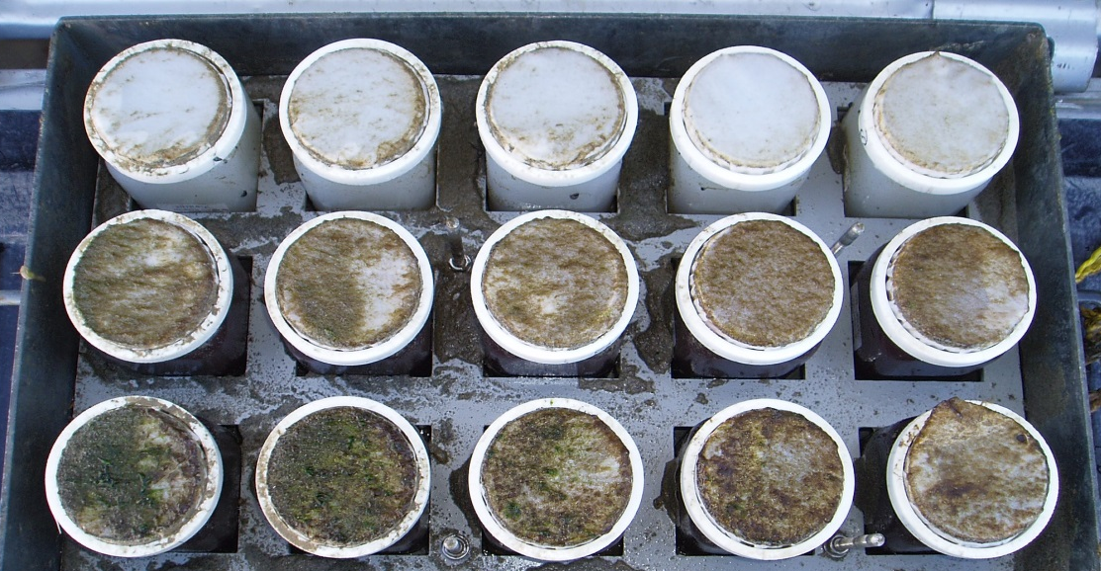

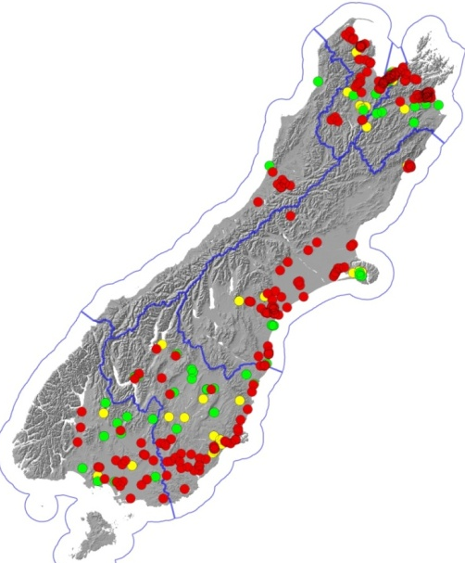
What does phosphorus do?
Control
+ P
+ N
69-78%
of sites
P-limited

Slide 3
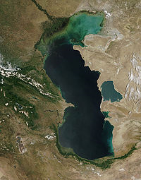
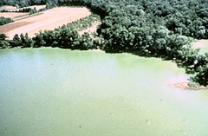
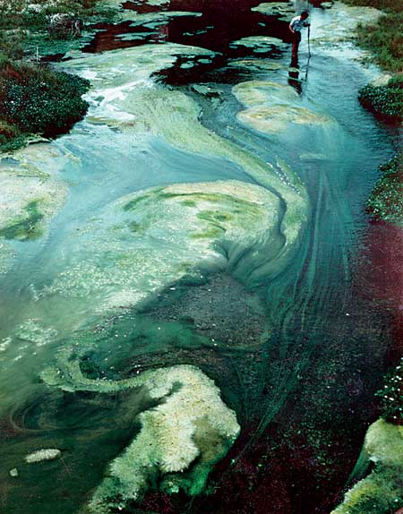
Distribution and significance of the issue
Effects:
- Increased algal biomass (toxic)
- Reduced water clarity
- Taste and odour problems
- Poor habitat
- Increased probably of fish kills
- Decrease aesthetic/recreation
Caspian Sea
Potomac River
Costs:
- £75-114M/yr UK water treatment
- >$1B decreased fishing revenue over
10 yrs in Chesapeake Bay
- 100M/yr lost recreation revenue NZ
Maharakeke Stream

Slide 4
Sources: Soil
High (50)
Medium (25)
Low (5)
V. high (85)

Slide 5
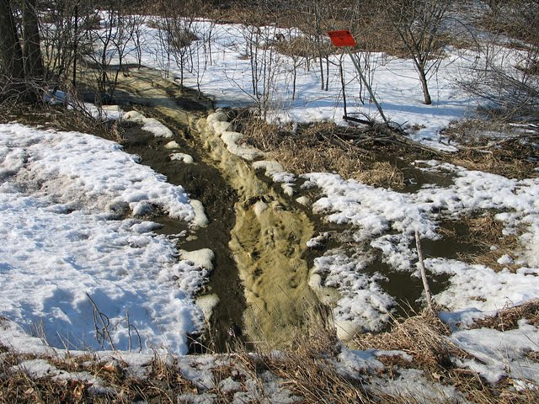
Sources: Fertiliser,
Manure, Grazing
Rate
Placement
Timing

Slide 6
In an equal world…
2004
Losses would reflect amount of P available for loss
Runoff 7 days
after application
2005

Slide 7
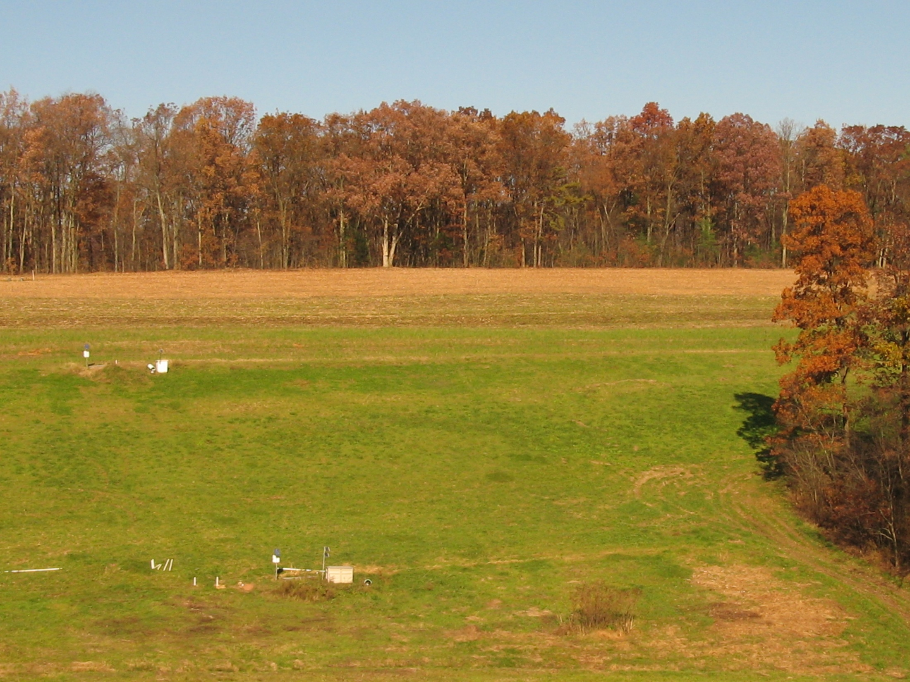
Hydrology and runoff can control P loss
21,757 L
Berks soil
no fragipan
Soil P = 177 mg kg⁻¹
86 L
0.1 g
4 g
Albrights soil
fragipan
Soil P = 78 mg kg⁻¹
Source: Buda et al. (2009)

Slide 8
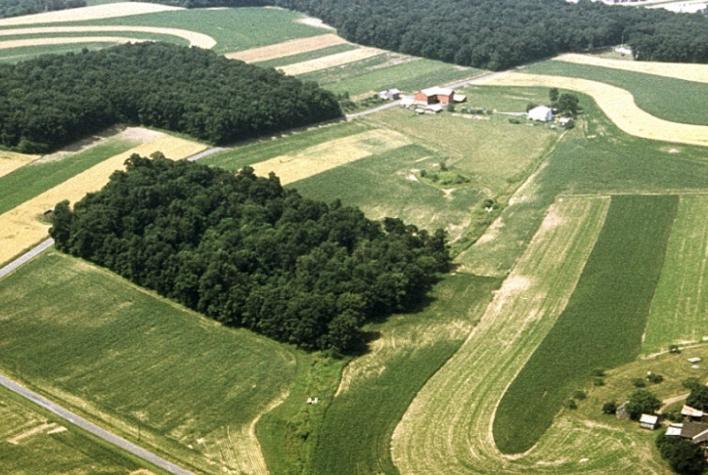


Management of source & transport
Risk
Low (clear)
Medium
High
Source +
80% of losses come from 20% of area
Concentrating mitigation and P use efficiency on critical source areas is the most cost-effective method of reaching an environmental target
Transport = risk

Slide 9
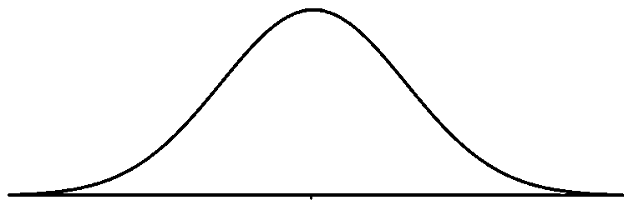
A policy response…
Laggards:
Prohibit detrimental practice
Leaders:
Advance good practice
1. Intensive regulatory approach
could miss losses
stifles innovation
2. Voluntary approach
relies on good will
hard to pin-point effect
3. Combined model
(must be based on good system knowledge
and targeting e.g. cost-effectiveness)

Slide 10
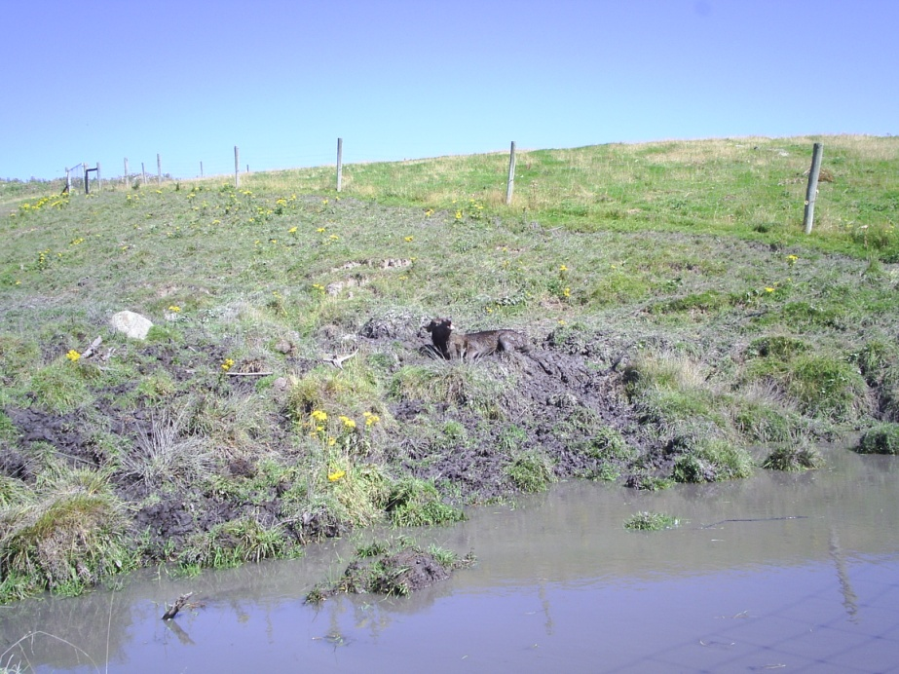
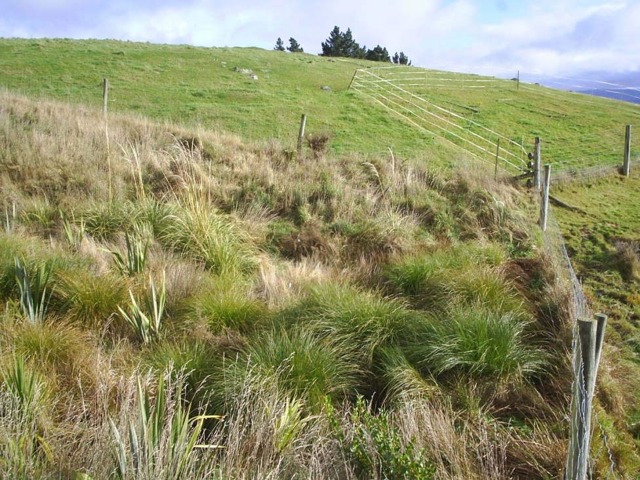
Example of poor regulation via stream fencing
2004
2009 – after fencing
Target

Slide 11
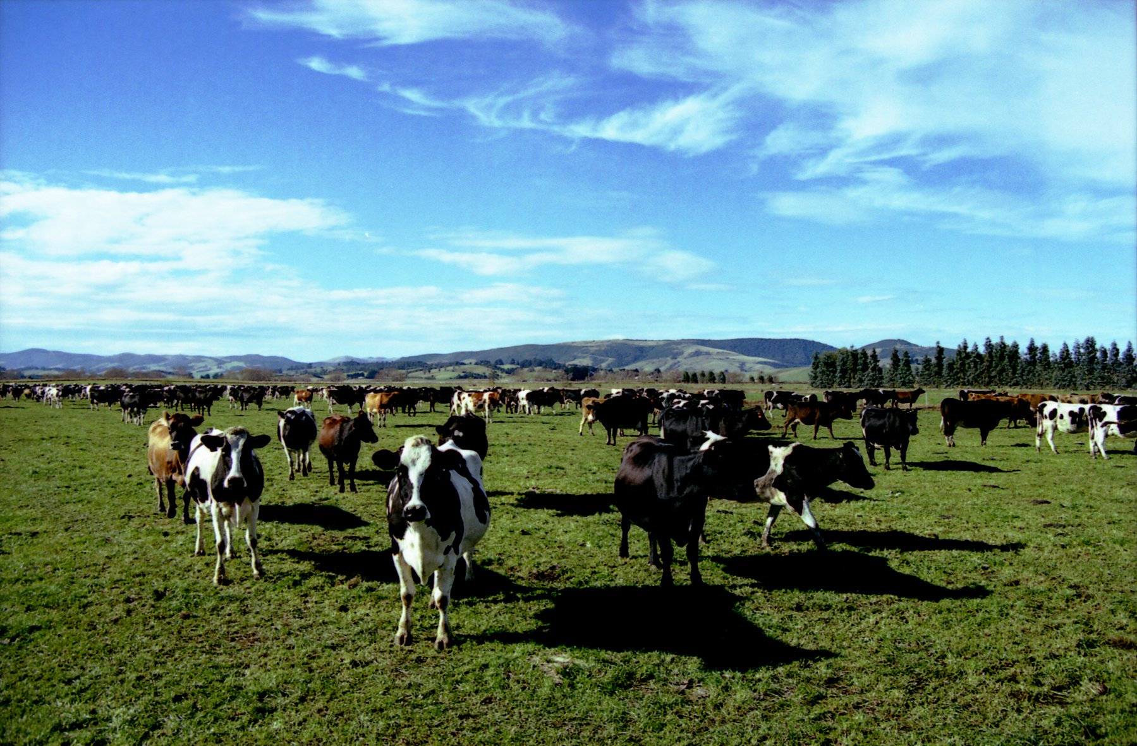
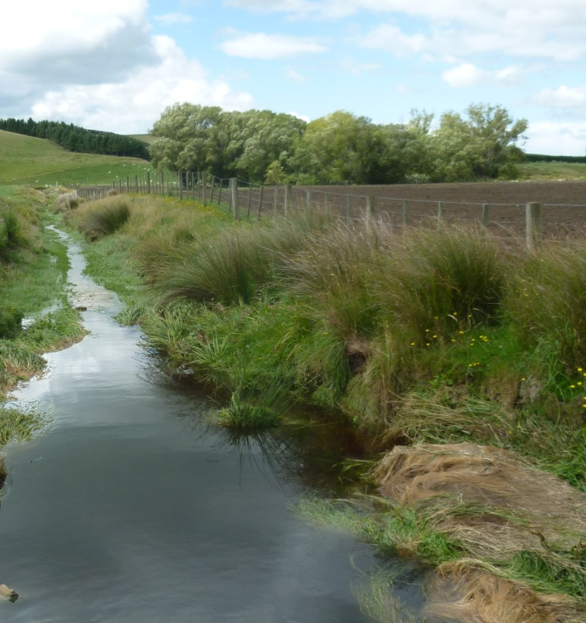
Combined model: define problem
PUBLIC called 30% less periphyton in the river and tributaries.
POLICY is that median DRP during summer-autumn should not be > 0.02 mg/L, down from 0.07 mg/L

Slide 12
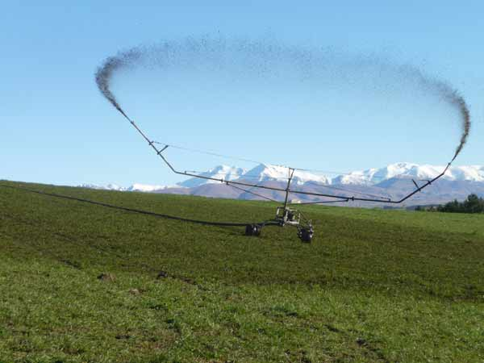
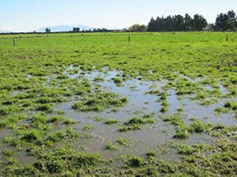
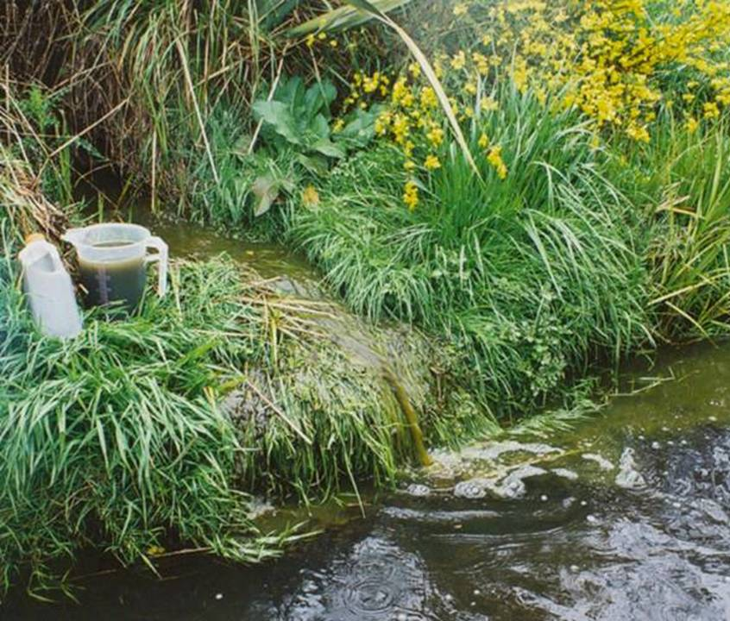
Combined model: define main leakage
Too much effluent applied at too high a rate
Notes:
12

Slide 13
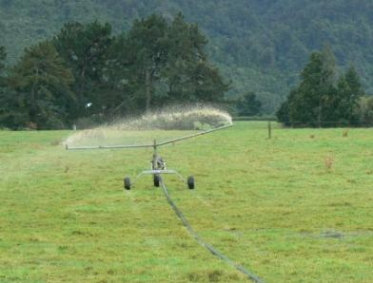
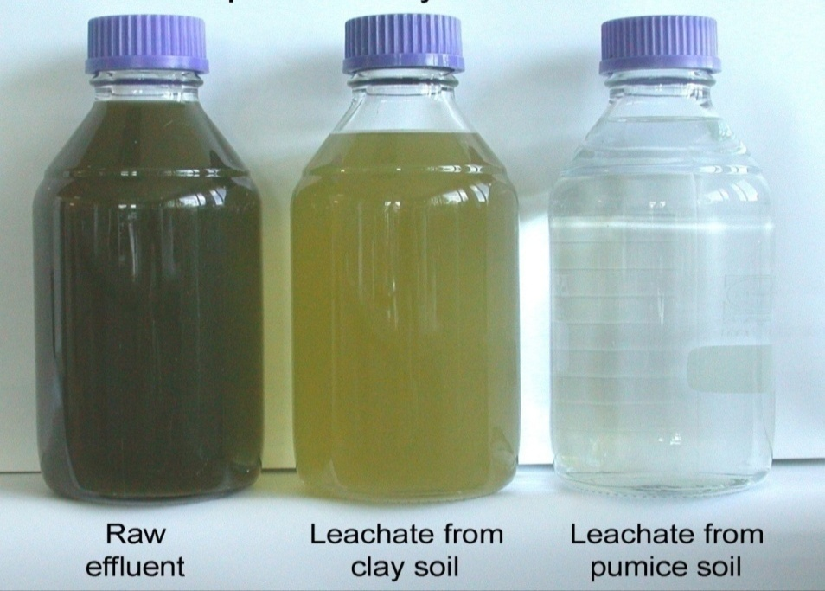
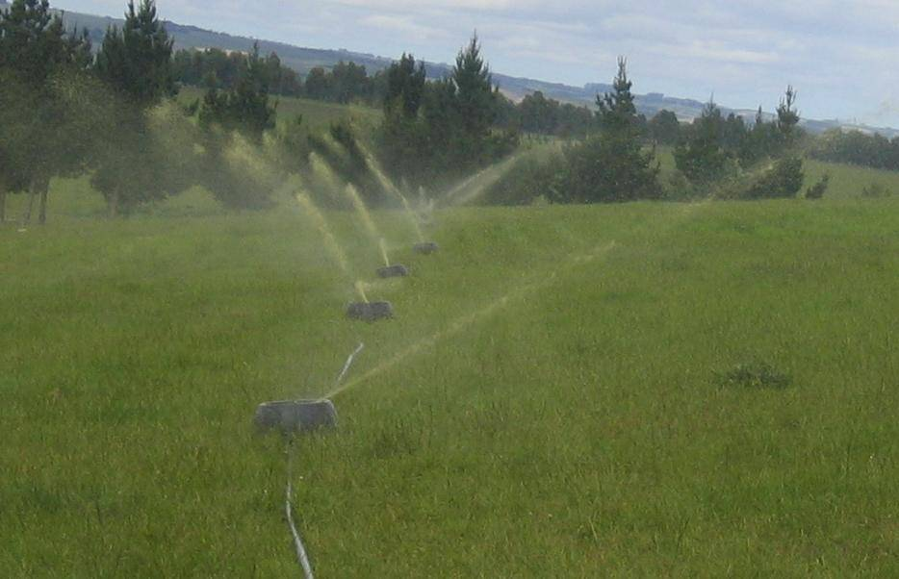
Combined model: prescribe mitigation to fix mian leakage
100
High rate irrigator
Low rate irrigator
90
80
70
60
Concentration relative to
effluent applied
50
40
30
20
10
Total P
NH₄⁺-N
E. coli

Slide 14
Combined model: educate on cost-effectiveness of applying next mitigation to CSAs
Strategy |  | Effectiveness (%) | Cost ($/kg P conserved)
Optimum soil test P | Management | 5-20 | highly cost-effective
Split grass-clover pastures |  | 0-40 | Highly cost-effective
Low solubility P fertilizer |  | 0-20 | 0-25
Restricted grazing |  | 30-50 | 125-200
Tile drain | Amendment | 50 | 20-75
Alum to pasture / cropland |  | 5-30 | 125->400
Buffer strips | Edge of field | 0-10 | >200
Stream fencing |  | 10-30 | 4-55
Sorbents in and near streams |  | 20 | 300
Natural and constructed wetlands |  | -426-77 | >400

Slide 15
Mixed model: innovative management of CSAs
Example:
Ryegrass produces well at low soil test P. However, higher soil test P (and loss?) is required to maintain clover.
Ryegrass yield
Clover yield
Phosphorus loss from soil
15
40
Olsen P (mg/L)

Slide 16
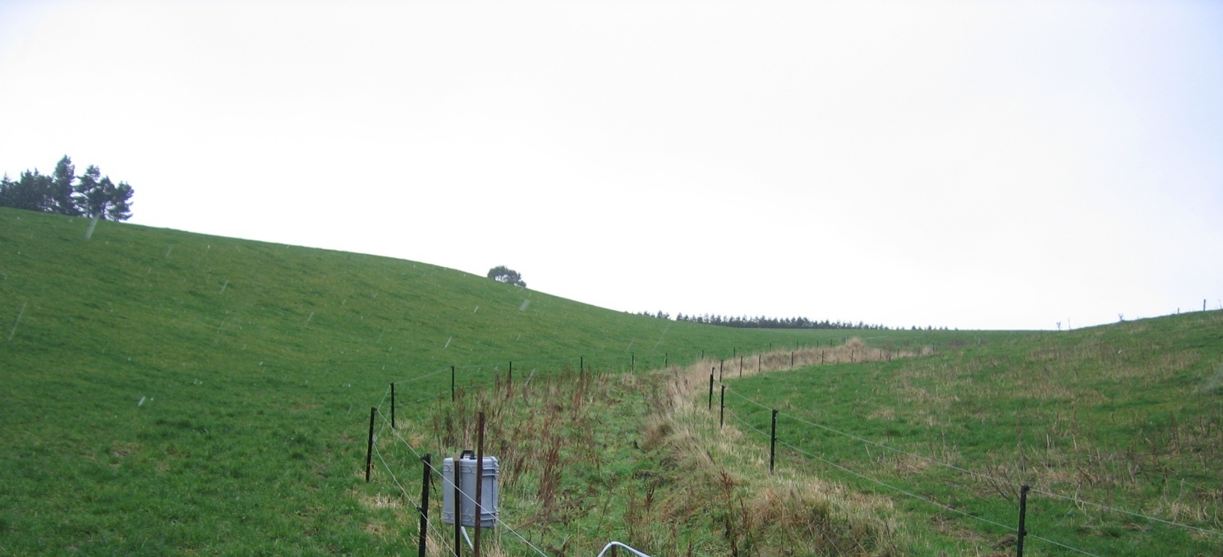
Mixed model: innovative management of CSAs
Answer:
Place clover in areas of a catchment unlikely to contribute runoff to the stream.
Decreases
DRP loss by 45%

Slide 17
Mixed model: management of CSAs at farm scale
$0
-$30
$15
$429
Change in profit ($/ha/yr)
Proposed target
Reference condition

Slide 18
SUMMARY
For a 1-2 kg P/ha loss, common sources are:
Soil 40-60%; Fertiliser = 10-15%; Manure/Grazing = 25-50%
Much P loss comes from critical source areas
A good policy response would be:
Set clear objectives (including anthropogenic load)
Target mitigation strategies to CSAs
Allow flexibility in strategies (educate on cost-effectiveness)
Challenge that critical source areas of P loss can be identified and treated successfully (with time) to minimise compliance costs.

